Slide 1
EMTH403
Mathematical Foundation for Computer Science

Slide 2
Lecture Outcomes
understand what are partial ordering
understand what are comparable and incomparable elements
understand what are total, well and lexicographic ordering

Slide 3
Partial Orderings
A relation R on a set S is called a partial ordering or partial order if it is reflexive, antisymmetric, and transitive.
A set S together with a partial ordering R is called a partially ordered set, or poset, and is denoted by (S,R). Members of S are called elements of the poset.

Slide 4
Partial Orderings – Example 1
Ques:- Show that the “greater than or equal” relation (≥) is a partial ordering on the set of integers.
Ans:- Because a ≥ a for every integer a, ≥ is reflexive. If a ≥ b and b ≥ a, then a = b.
Hence, ≥ is antisymmetric. Finally, ≥ is transitive because a ≥ b and b ≥ c imply that a ≥ c.
It follows that ≥ is a partial ordering on the set of integers and (Z, ≥) is a poset.

Slide 5
Partial Orderings – Example 2
Ques:- Show that the inclusion relation ⊆ is a partial ordering on the power set of a set S.
Ans:- Because A ⊆ A whenever A is a subset of S, ⊆ is reflexive.
It is antisymmetric because A ⊆ B and B ⊆ A imply that A = B.
Finally, ⊆ is transitive, because A ⊆ B and B ⊆ C imply that A ⊆ C.
Hence, ⊆ is a partial ordering on P(S), and (P (S),⊆) is a poset.

Slide 6
Partial Orderings – Example 3
Ques:- Is the following relation on {0, 1, 2, 3} a partial orderings? Determine the properties of a partial ordering that the others lack. {(0, 0), (1, 1), (2, 2), (3, 3)}
Ans:- This is just the equality relation on {O, 1, 2, 3}; more generally, the equality relation on any set satisfies all three conditions and is therefore a partial ordering.

Slide 7
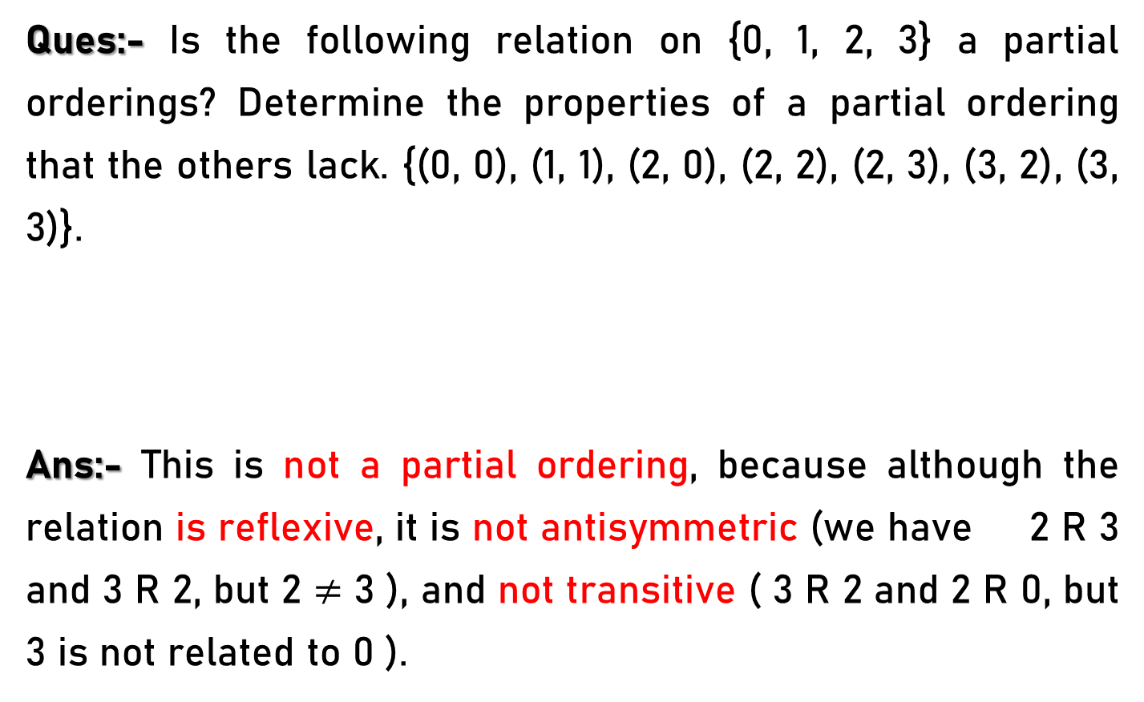
Partial Orderings – Example 4
Ques:- Is the following relation on {0, 1, 2, 3} a partial orderings? Determine the properties of a partial ordering that the others lack. {(0, 0), (1, 1), (2, 0), (2, 2), (2, 3), (3, 2), (3, 3)}.
Ans:- This is not a partial ordering, because although the relation is reflexive, it is not antisymmetric (we have 2 R 3 and 3 R 2, but 2 $≠$ 3 ), and not transitive ( 3 R 2 and 2 R 0, but 3 is not related to 0 ).

Slide 8
Partial Orderings – Example 5
Ques:- Is the following relation on {0, 1, 2, 3} a partial orderings? Determine the properties of a partial ordering that the others lack. {(0, 0), (1, 1), (1, 2), (2, 2), (3, 3)}
Ans:- This is a partial ordering, because it is clearly reflexive; is antisymmetric (we just need to note that (1, 2) is the only pair in the relation with unequal components); and is transitive (for the same reason).

Slide 9
Partial Orderings – Example 6
Ques:- Is the following relation on {0, 1, 2, 3} a partial orderings? Determine the properties of a partial ordering that the others lack. {(0, 0), (1, 1), (1, 2), (1, 3), (2, 2), (2, 3), (3, 3)}
Ans:- This is a partial ordering because it is the "less than or equal to" relation on {1, 2, 3} together with the
isolated point 0.

Slide 10
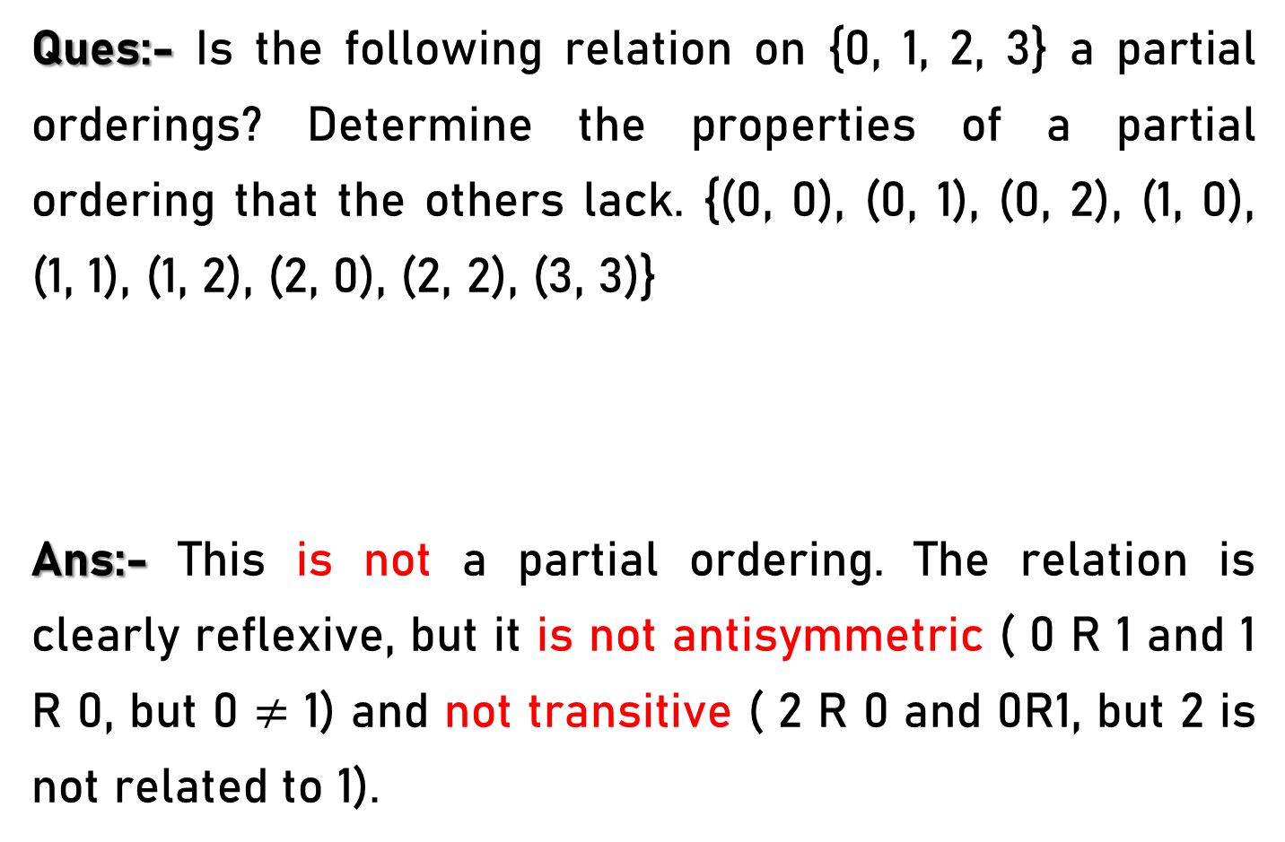
Partial Orderings – Example 7
Ques:- Is the following relation on {0, 1, 2, 3} a partial orderings? Determine the properties of a partial ordering that the others lack. {(0, 0), (0, 1), (0, 2), (1, 0), (1, 1), (1, 2), (2, 0), (2, 2), (3, 3)}
Ans:- This is not a partial ordering. The relation is clearly reflexive, but it is not antisymmetric ( 0 R 1 and 1 R 0, but 0 $≠$ 1) and not transitive ( 2 R 0 and 0R1, but 2 is not related to 1).

Slide 11
Partial Orderings – Example 8
Ques:- Let R be the relation on the set of people such that xRy if x and y are people and x is older than y. Show that R is not a partial ordering.
Ans:- R is not reflexive, because no person is older than himself or herself.
That is, x R x for all people x. It follows that R is not a partial ordering.

Slide 12
Comparable
The elements a and b of a poset (S, ) are called comparable if either a b or b a.
When a and b are elements of S such that neither
a b nor b a, a and b are called incomparable

Slide 13
Comparable – Example 1
Ques:- In the poset (Z⁺, |), are the integers 3 and 9 comparable?
Ans:- The integers 3 and 9 are comparable, because 3 | 9.

Slide 14
Comparable – Example 2
Ques:- In the poset (Z⁺, |), are 5 and 7 comparable?
Ans:-
The integers 5 and 7 are incomparable, because
5 | 7 and 7 | 5.

Slide 15
Totally ordered set
If (S, ) is a poset and every two elements of S are comparable, S is called a totally ordered or linearly ordered set, and is called a total order or a linear order.
A totally ordered set is also called a chain.

Slide 16
Totally ordered set - Example
Example 1:- The poset (Z,≤) is totally ordered, because a ≤ b or b ≤ a whenever a and b are integers.
Example 2:- The poset (Z⁺, | ) is not totally ordered because it contains elements that are incomparable, such as 5 and 7.

Slide 17
Well-ordered set
(S, ) is a well-ordered set if it is a poset such that is a total ordering, and every nonempty subset of S has a least element.

Slide 18
Well-ordered set – Examples
Example 1:- The set of ordered pairs of positive integers, Z⁺× Z⁺, with (a₁, a₂) (b₁, b₂) if a₁ < b₁, or if a₁ = b₁ and a₂ ≤ b₂ (the lexicographic ordering), is a well-ordered set.
Example 2:- The set Z, with the usual ≤ ordering, is not well-ordered because the set of negative integers, which is a subset of Z, has no least element.

Slide 19
Lexicographic Order - Example
The words in a dictionary are listed in alphabetic, or lexicographic, order, which is based on the ordering of the letters in the alphabet.
Consider the set of strings of lowercase English letters.
discreet ≺ discrete,
because these strings differ first in the seventh position, and e ≺ t .

Slide 20
Lexicographic Order - Example
Also,
discreet ≺ discreetness, because the first eight letters agree, but the second string is longer.
Furthermore, discrete ≺ discretion, because discrete ≺ discreti.

Slide 21
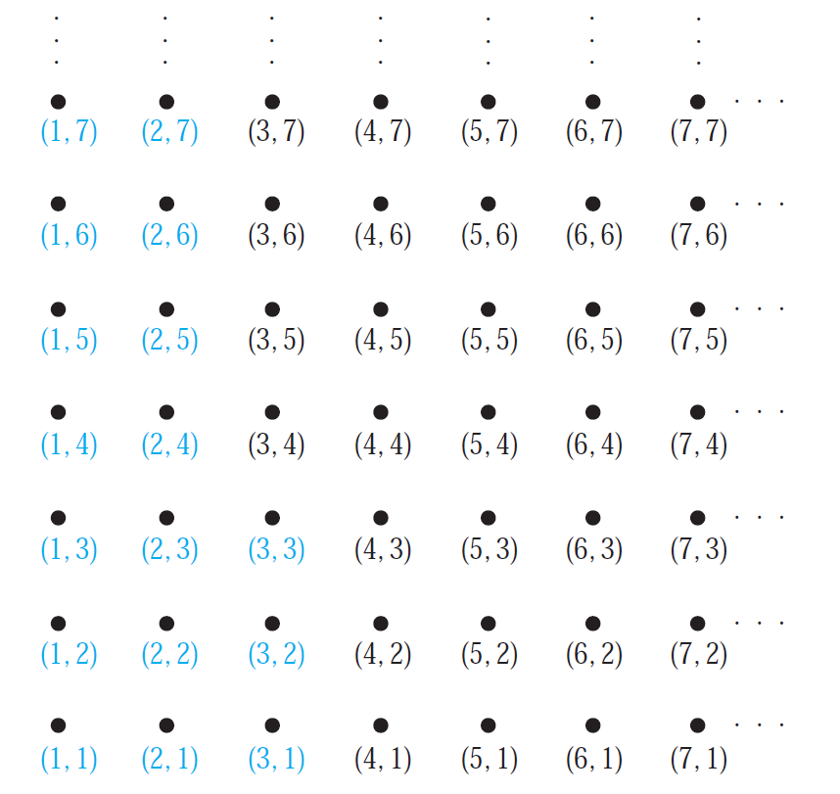
Lexicographic Order
The Ordered Pairs Less Than (3, 4) in Lexicographic Order.

Slide 22
Lexicographic Order - Examples
Ques:- Find the lexicographic ordering of these n-tuples:
a) (1, 1, 2), (1, 2, 1)
Ans:- (1, 1, 2) < (1, 2, 1).
b) (0, 1, 2, 3), (0, 1, 3, 2)
Ans:- (0, 1, 2, 3) < (0, 1, 3, 2).
c) (1, 0, 1, 0, 1), (0, 1, 1, 1, 0)
Ans:- (0, 1, 1, 1, 0) < (1, 0, 1, 0, 1).

